Slide 1
Weekly Poor PDP Case Review
Aug 31 - Sep 13, 2026

Slide 2
Weekly Poor PDP Case Review
Overview | Aug 31 - Sep 13, 2026
Metric | Value
Total Poor Case in last 2 weeks | 96
Total Types of Product | 22
Total Case related to Log Team (%) | 65 (67.7%)
Total Case not related to Log Team (%) | 31 (32.3%)

Slide 3
Weekly Poor PDP Case Review
Problems Pattern | Aug 31 - Sep 13, 2026
Problem | Cases | Products | %
包裝問題 | 25 | 12 | 38.5%
其他 | 22 | 14 | 33.8%
儲存問題 | 10 | 1 | 15.4%
溫度問題 | 5 | 2 | 7.7%
罐裝問題 | 2 | 2 | 3.1%
天雨/水濕問題 | 1 | 1 | 1.5%

Slide 4
Weekly Poor PDP Case Review
Comparison of Performance by Districts | Aug 31 - Sep 13, 2026
Rank | District | Cases | Rep. Product (ID + Name) | % of Log Team
1 | ETX | 19 | H0888001_S_P10016911 | 頂上茉莉香米 #金象#金象牌#香米#米#煮食#煮飯#煲仔飯#... | 29.2%
2 | NT-TW | 11 | H0888001_S_10134490 | 除霉噴劑 (新舊包裝隨機發送) | 16.9%
3 | ETK | 9 | H0888001_S_P10016911 | 頂上茉莉香米 #金象#金象牌#香米#米#煮食#煮飯#煲仔飯#... | 13.8%
4 | ETH | 7 | H0888001_S_P10020854 | [原箱] 屈臣氏蒸餾水 800ml X 24 (新舊包裝隨機... | 10.8%
5 | WTK | 6 | H0888001_S_10020138 | [官方供應] 亨氏清雞湯 #上等嫩雞 #不含人造色素和防腐劑 ... | 9.2%
6 | NT-TSM | 5 | H0888001_S_10136268A | 玉泉梳打水330ml x 8罐裝 x 2 (新舊包裝隨機發送... | 7.7%
7 | NT-ST | 3 | H0888001_S_P10016911 | 頂上茉莉香米 #金象#金象牌#香米#米#煮食#煮飯#煲仔飯#... | 4.6%
8 | WTH | 2 | H0888001_S_10016316 | 可口可樂無糖汽水 [罐裝] 330ml x 12 (新舊包裝隨... | 3.1%
9 | WTX | 2 | H0389001_S_4891203504428 | 3M 護齒牙縫刷 - L型 SSSS碼 新包裝 | 3.1%
10 | NT-TM | 1 | H7659002_S_OMFF0008 | 紅衫魚 (已去內臟 2-4條裝) 400g (急凍-18°C)... | 1.5%
Total Log Team Cases: 65 | Sum%: 99.9%

Slide 5
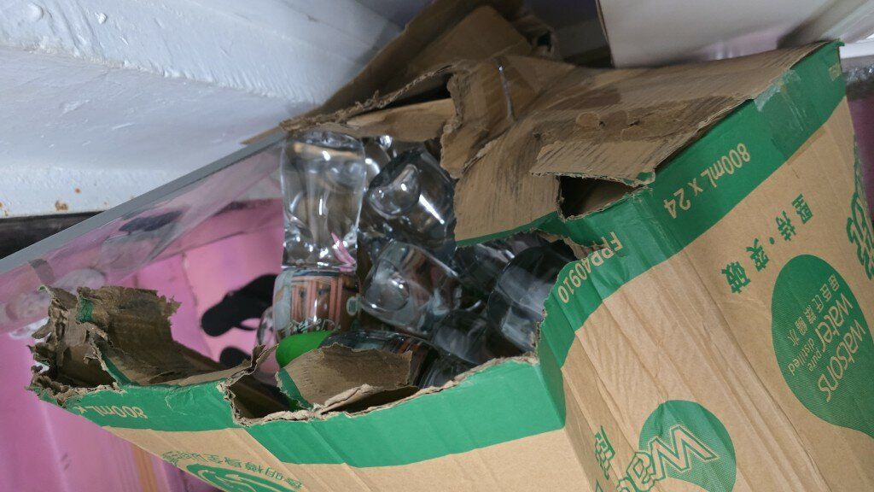
Weekly Poor PDP Case Review
Case Review - 包裝問題 (25 cases in window)
Product ID: H0888001_S_P10020854 | [原箱] 屈臣氏蒸餾水 800ml X 24 (新舊包裝隨機發送)
District: ETH
Shipping Warehouse: 將軍澳倉
Pickpack Warehouse: Warehouse貨
Order: H260830506534 | Waybill: 8155303574-1
Checking Result: 天雨關係, 貨物紙皮濕左變軟變爛非人為可控制原因, 內容物未有受損回倉更換紙箱亦是最環保及符合成本的方法
送貨員成箱掉落地，爛哂，5箱水有2箱都爛哂，全部水跌哂出黎，仲話唔要收返去都係貼返好個箱再送返比我，甘都得
1/2

Slide 6
Weekly Poor PDP Case Review
Case Review - 包裝問題 (25 cases in window)
Product ID: H0888001_S_P10020854 | [原箱] 屈臣氏蒸餾水 800ml X 24 (新舊包裝隨機發送)
[No valid photo link]
District: ETK
Shipping Warehouse: 將軍澳倉
Pickpack Warehouse: Warehouse貨
Order: H260902513252 | Waybill: 8161282559-2
Checking Result: [原箱] 屈臣氏蒸餾水該款包裝箱為再做紙, 比較軟身及易爛
每次包裝盒總是損壞。
2/2

Slide 7
Weekly Poor PDP Case Review
Case Review - 其他 (22 cases in window)
Product ID: H0888001_S_10134752 | 純牛奶
[No valid photo link]
District: ETX
Shipping Warehouse: 觀塘倉
Pickpack Warehouse: Warehouse貨
Order: H260902530027 | Waybill: 8161998605-2
Checking Result: 品質問題
買咗6包，飲第2包時，樽奶係酸嘅
1/2

Slide 8
Weekly Poor PDP Case Review
Case Review - 其他 (22 cases in window)
Product ID: H0888001_S_10134752 | 純牛奶
[No valid photo link]
District: NT-TW
Shipping Warehouse: 青衣倉
Pickpack Warehouse: Warehouse貨
Order: H260904523501 | Waybill: 8165105179-2
Checking Result: 同事派送時未有發現有貨品欠缺問題
未送齊商品，之後只能補回價錢，不能補回貨品
2/2

Slide 9
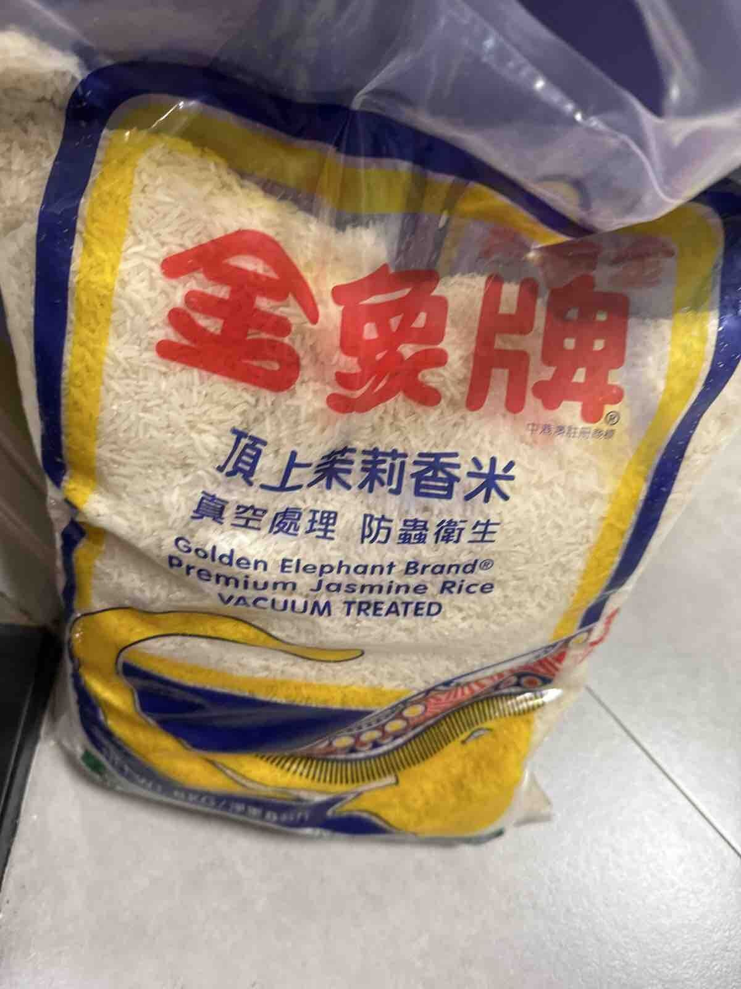
Weekly Poor PDP Case Review
Case Review - 儲存問題 (10 cases in window)
Product ID: H0888001_S_P10016911 | 頂上茉莉香米 #金象#金象牌#香米#米#煮食#煮飯#煲仔飯#金象米
District: ETK
Shipping Warehouse: 將軍澳倉
Pickpack Warehouse: Warehouse貨
Order: H260822520688 | Waybill: 8139786920-1
Checking Result: 在貨品出倉時已經不是真空包裝
買錯了三包. 得1 包 有真空 無損
買錯我問題 無抽真空 會生谷牛 有昆虫 唔放得耐😵
1/2

Slide 10
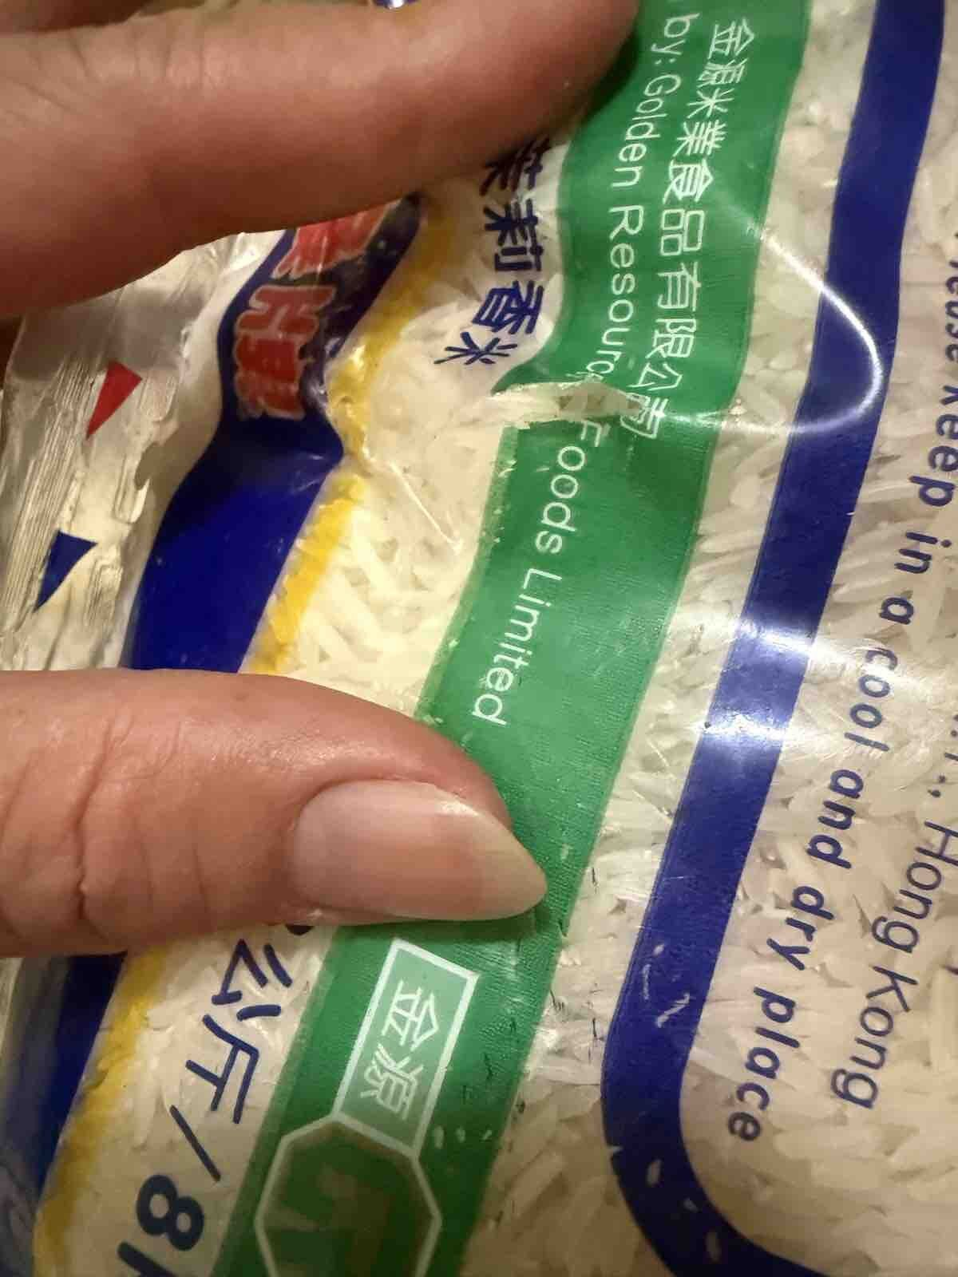
Weekly Poor PDP Case Review
Case Review - 儲存問題 (10 cases in window)
Product ID: H0888001_S_P10016911 | 頂上茉莉香米 #金象#金象牌#香米#米#煮食#煮飯#煲仔飯#金象米
District: ETX
Shipping Warehouse: 觀塘倉
Pickpack Warehouse: Warehouse貨
Order: H260829545858 | Waybill: 8154161367-1
Checking Result: 上貨時已非全部都真空
買咗5包米，全部冇真空包裝，而且仲有穿窿！非常失望，喺百佳網購幾包米起碼有一半係真空包裝，呢度買全部冇真空，估計打八五折就係咁嘅原因！極之失望
2/2

Slide 11
Weekly Poor PDP Case Review
Case Review - 溫度問題 (5 cases in window)
Product ID: H7659002_S_OMFF0005 | 野生大眼雞(長尾木棉) (已去內臟) 2-4條裝 (急凍-18°C)(新舊包裝隨機發放)
[No valid photo link]
District: ETX
Shipping Warehouse: 觀塘倉
Pickpack Warehouse: Merchant貨
Order: H260828541488 | Waybill: 8151856529
Checking Result: 沒有圖片未能查看
冷藏平均: -0.7 | 急凍平均: -11.7 | 冷藏最低: -4.1 | 急凍最低: -20.1
今次尼兩條魚又腥又臭魚肚不乾淨兩條魚色澤暗紫色以後都不會購買, 以往多次回購魚肚很乾淨
1/2

Slide 12
Weekly Poor PDP Case Review
Case Review - 溫度問題 (5 cases in window)
Product ID: H7659002_S_OMFF0005 | 野生大眼雞(長尾木棉) (已去內臟) 2-4條裝 (急凍-18°C)(新舊包裝隨機發放)
[No valid photo link]
District: ETX
Shipping Warehouse: 觀塘倉
Pickpack Warehouse: Merchant貨
Order: H260901536105 | Waybill: 8160672415
Checking Result: 冷機溫度正常
冷藏平均: 4.3 | 急凍平均: -9.5 | 冷藏最低: -1 | 急凍最低: -16.7
食品已壞掉有臭味，要求退款
2/2

Slide 13
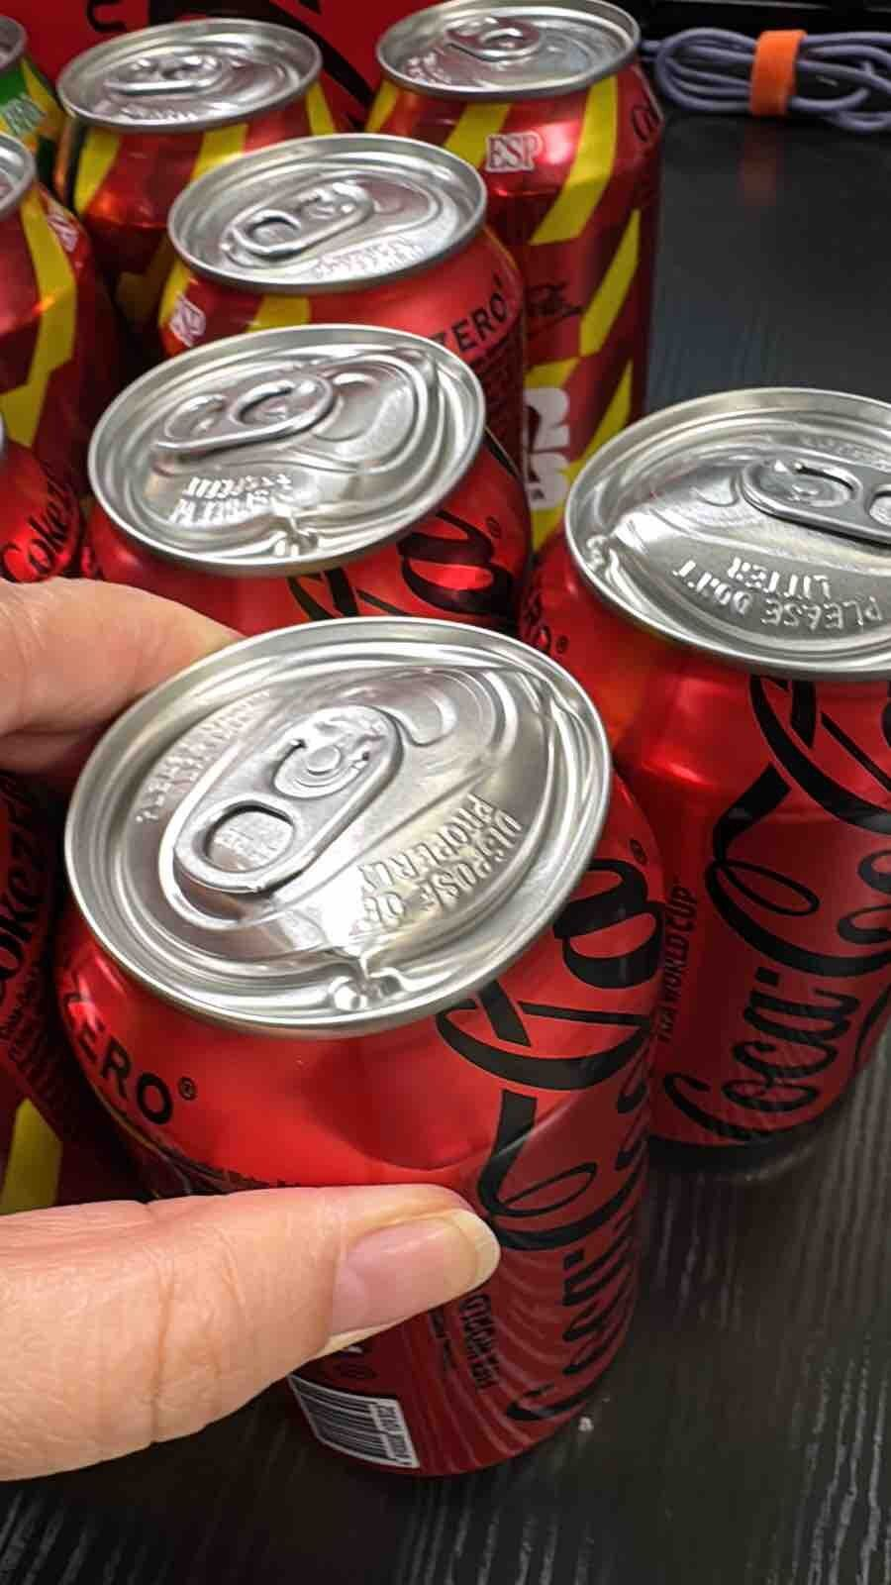
Weekly Poor PDP Case Review
Case Review - 罐裝問題 (2 cases in window)
Product ID: H0888001_S_10016316 | 可口可樂無糖汽水 [罐裝] 330ml x 12 (新舊包裝隨機發送)
District: ETX
Shipping Warehouse: 觀塘倉
Pickpack Warehouse: Warehouse貨
Order: H260830502608 | Waybill: 8155121536-1
Checking Result: 倉儲溫度問題
12 罐入面有五罐係突出的，開汽水會爆出來的，包裝表面沒有凹陷的

Slide 14
Weekly Poor PDP Case Review
Case Review - 天雨/水濕問題 (1 cases in window)
Product ID: H0888001_S_P10020854 | [原箱] 屈臣氏蒸餾水 800ml X 24 (新舊包裝隨機發送)
District: ETX
Shipping Warehouse: 觀塘倉
Pickpack Warehouse: Warehouse貨
Order: H260830542529 | Waybill: 8156988115-1
Checking Result: 紙箱太軟, 一搬起就損壞
一箱水全部散開晒,唔係第一次，冇落雨都試過係咁樣

